Slide 1

Beliefs about bad people are volatile
Reporter: Li Xintong(李昕彤)
Date: 2022.3.4
Siegel, J. Z., Mathys, C., Rutledge, R. B., & Crockett, M. J. (2018). Beliefs about bad people are volatile. Nature human behaviour, 2(10), 750-756.

Slide 2
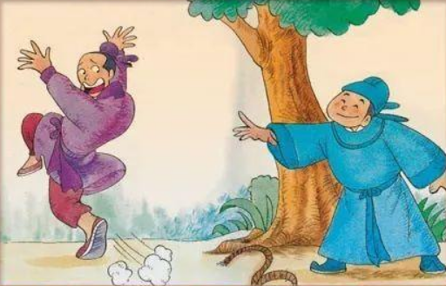
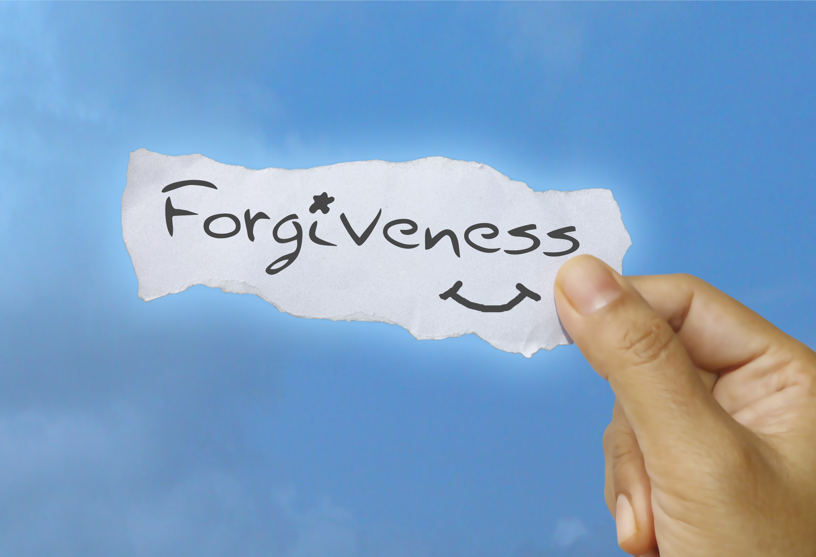
Introduction

Slide 3
Introduction
Attention—>Bad character
Terminate valuable relationships
Miss out on the potential benefits of future cooperative interactions

Slide 4
Introduction
Attention—>Bad character
Terminate valuable relationships
Miss out on the potential benefits of future cooperative interactions
When people form beliefs about the moral character of others, their impressions about bad agents are more uncertain than their impressions about good agents.

Slide 5
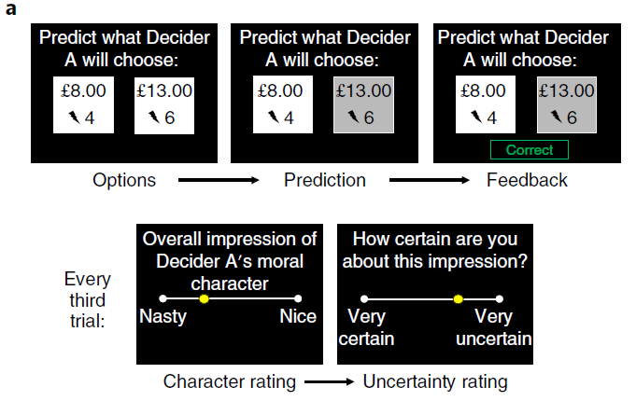
Paradigm

Slide 6
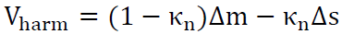
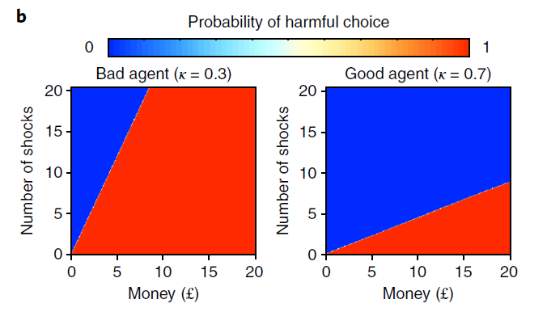
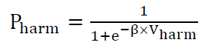
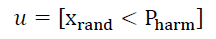
Agent
Deterministic choice preferences
random number between 0 and 1

Slide 7
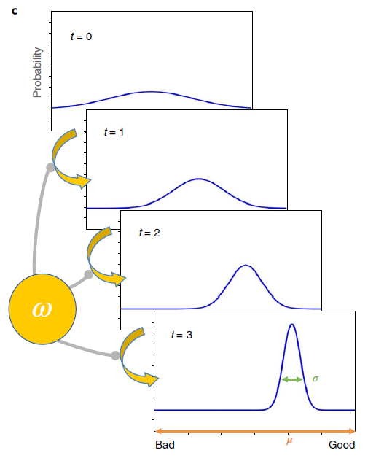
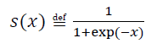
Hierarchical Gaussian Filter(HGF)
Perceptual Model
Two hidden states:
x1: the agent’s upcoming choice
x1 = 1: the more harmful option
x1 = 0: the less harmful option
x2: the agent’s (logit-transformed) κ
s(·) is a logistic sigmoid (softmax) function:

Slide 8
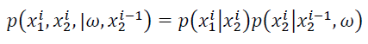
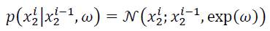
Hierarchical Gaussian Filter(HGF)
Perceptual Model
The temporal evolution of x2 is governed by a participant-specific parameter ω
ω captures inter-individual variability in the rate at which beliefs evolve over time
-∞ ………. ω ……….. ∞
stable
unstable

Slide 9
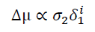
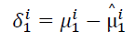
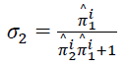
Hierarchical Gaussian Filter(HGF)
Perceptual Model
Model inversion was used to optimize the posterior densities over hidden states, x1 and x2, and parameter ω.
Participants’ posterior beliefs were represented by probability distributions with mean μ and variance σ.
Predictions prior to observing the outcome at trial i
Precision(1/σ) of level 1
Precision of level 2: κ

Slide 10
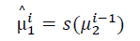
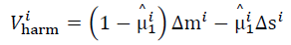
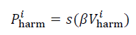
Hierarchical Gaussian Filter(HGF)
Decision Model

Slide 11
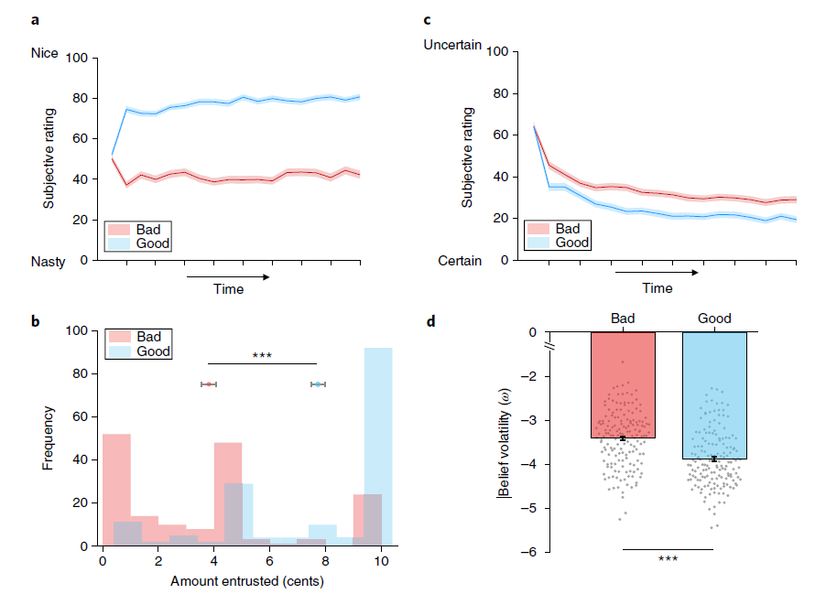
Results

Slide 12
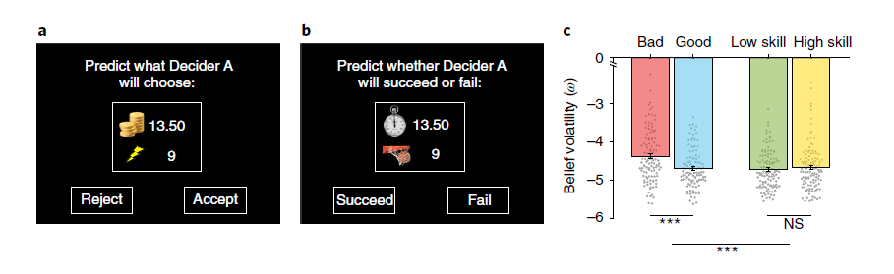
Results

Slide 13
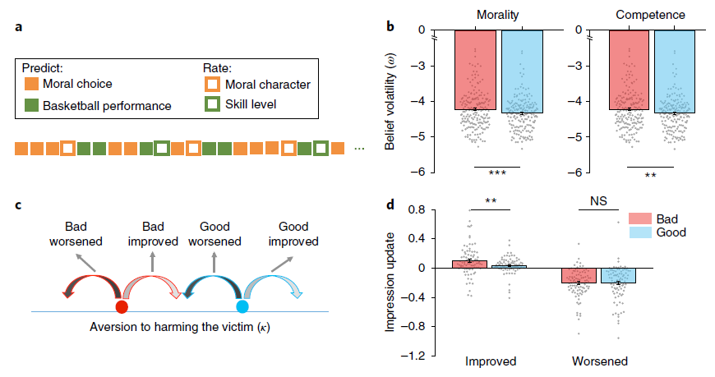
Results

Slide 14
Conclusion
Bad moral impressions are more volatile than good moral impressions.
1
Inferring bad character destabilized overall social impression formation, spilling over into learning about a non-moral trait.
2
When moral behaviour improved, impressions were updated faster for putatively bad agents than for good agents → forgiveness
3

Slide 15
Thank You!

